Slide 1
Simple Linear Regression
Adapted from METU

Slide 2
Simple Linear Regression
Our objective is to study the relationship between two variables X and Y.
One way is by means of regression.
Regression analysis is the process of estimating a functional relationship between X and Y. A regression equation is often used to predict a value of Y for a given value of X.
Another way to study relationship between two variables is correlation. It involves measuring the direction and the strength of the linear relationship.
2

Slide 3
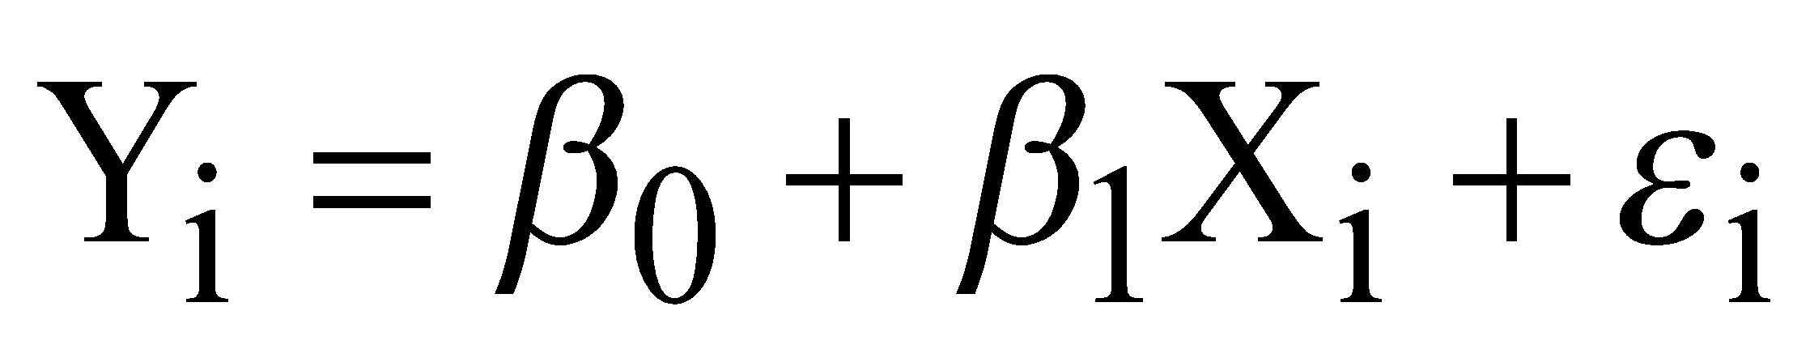
First-Order Linear Model = Simple Linear Regression Model
where
y = dependent variable
x = independent variable
β₀= y-intercept
β₁= slope of the line
ε = error variable
3

Slide 4
Simple Linear Model
This model is
Simple: only one X
Linear in the parameters: No parameter appears as exponent or is multiplied or divided by another parameter
Linear in the predictor variable (X): X appears only in the first power.
4

Slide 5
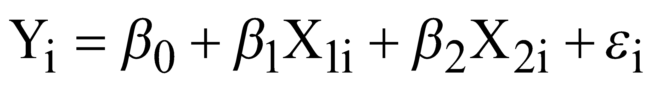
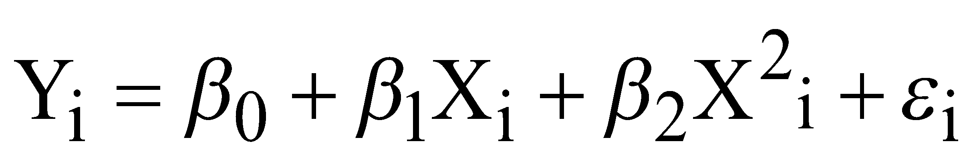
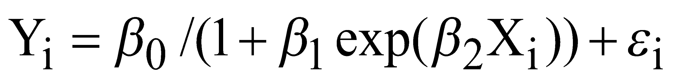
Examples
Multiple Linear Regression:
Polynomial Linear Regression:
Linear Regression:
Nonlinear Regression:
Linear or nonlinear in parameters
5

Slide 6
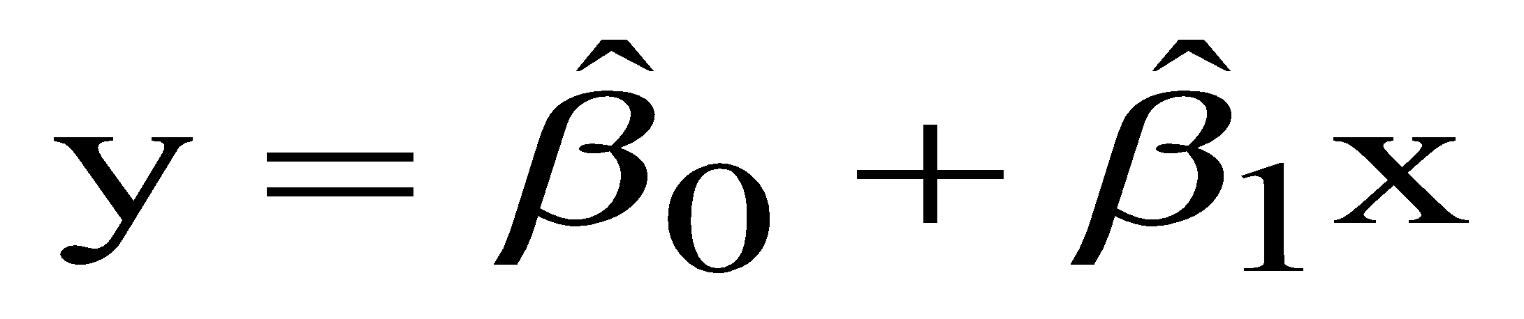
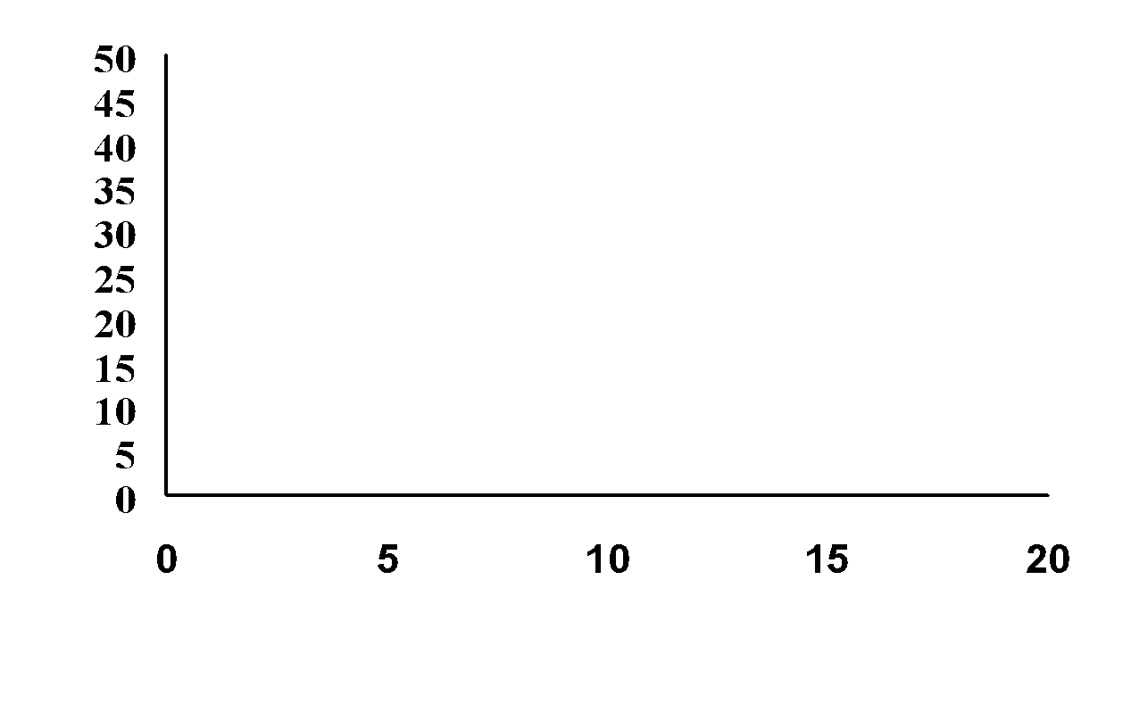
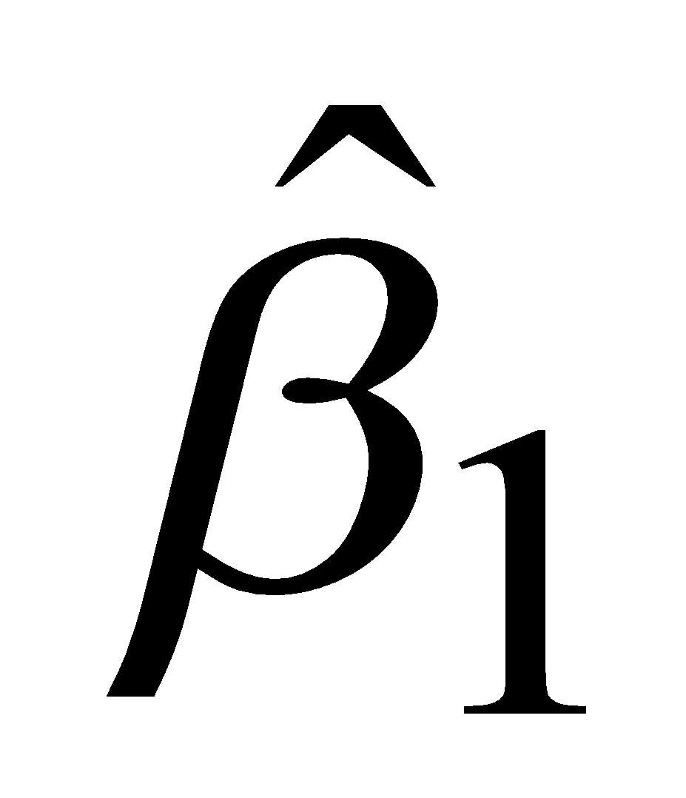
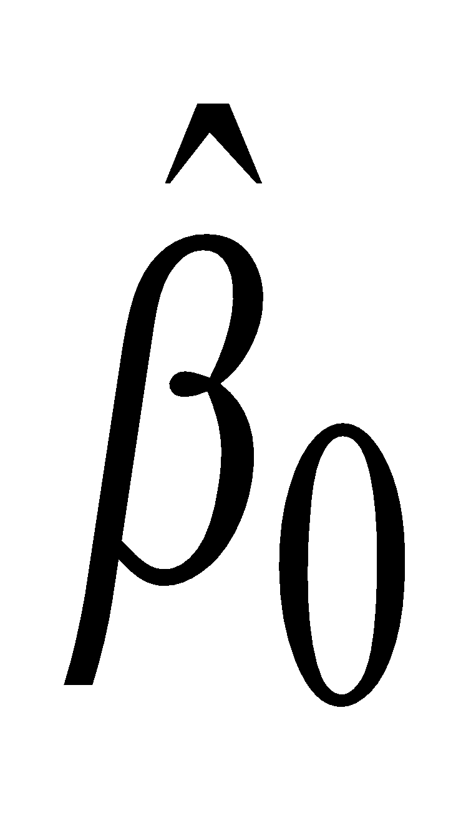
Deterministic Component of Model
y-intercept
∆y
(slope)=∆y/∆x
∆x
x
6

Slide 7
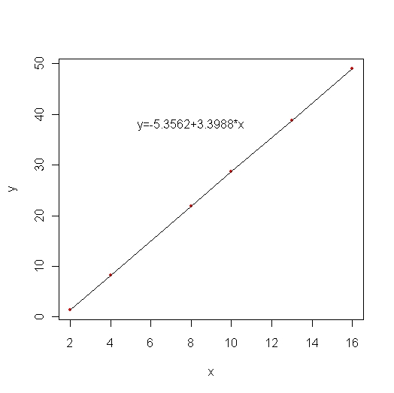
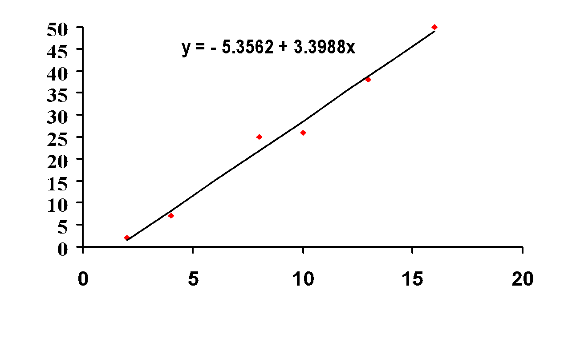
Mathematical vs Statistical Relation
^
x
x
7

Slide 8
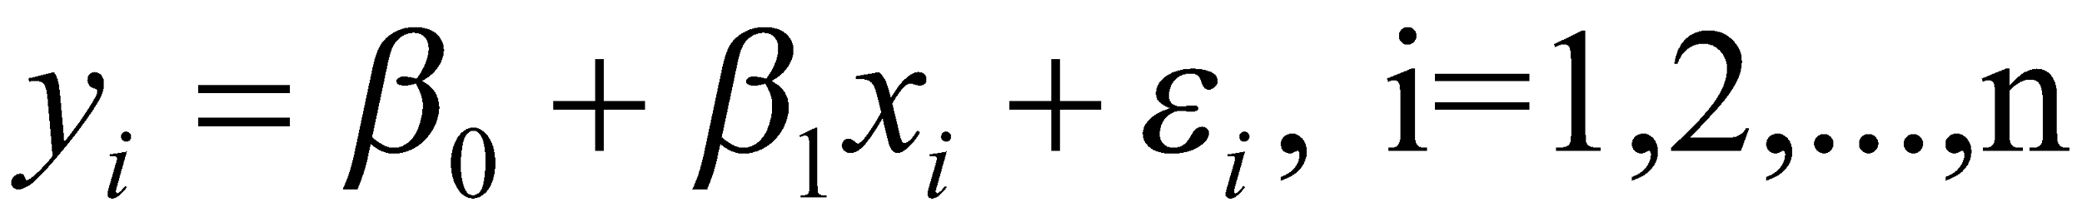
Error
The scatterplot shows that the points are not on a line, and so, in addition to the relationship, we also describe the error:
The Y’s are the response (or dependent) variable. The x’s are the predictors or independent variables, and the epsilon’s are the errors. We assume that the errors are normal, mutually independent, and have variance σ².
8

Slide 9
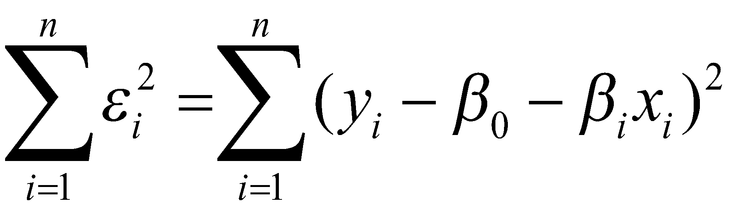
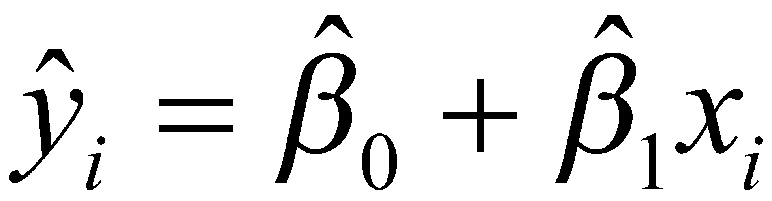
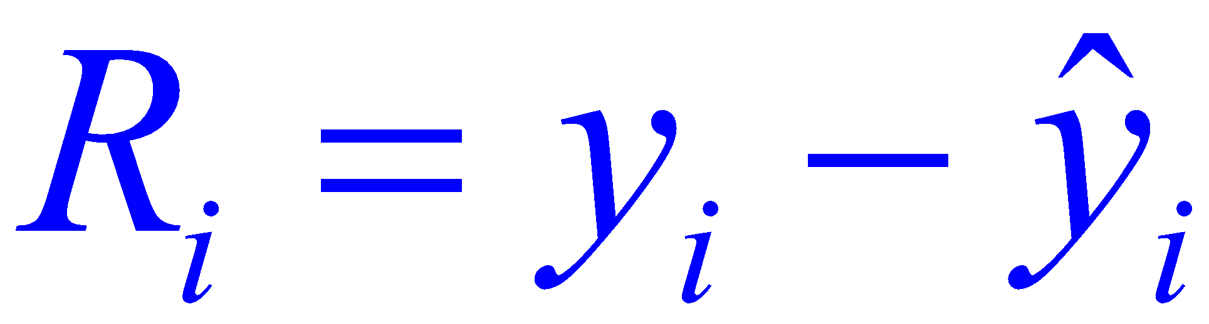
Least Squares:
Minimize
The quantities are called the residuals. If we assume a normal error, they should look normal.
Error: Yi-E(Yi) unknown; Residual: estimated, i.e. known
9

Slide 10
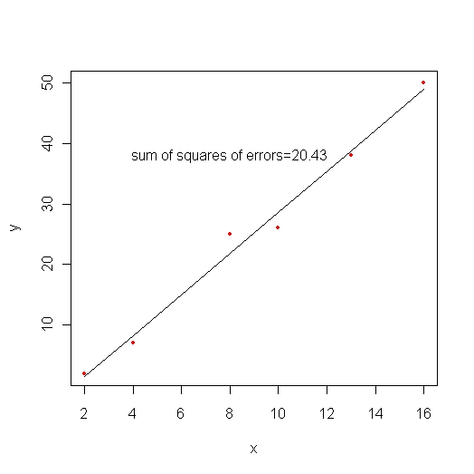
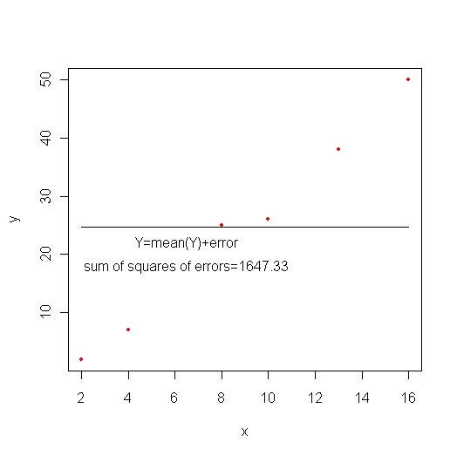
Minimizing error
10

Slide 11
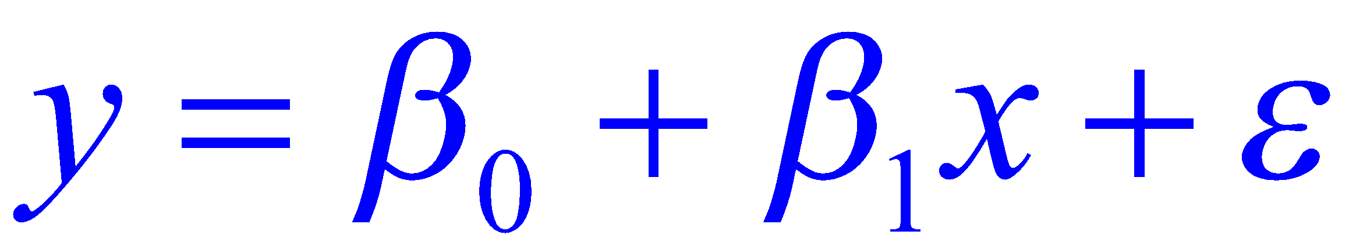
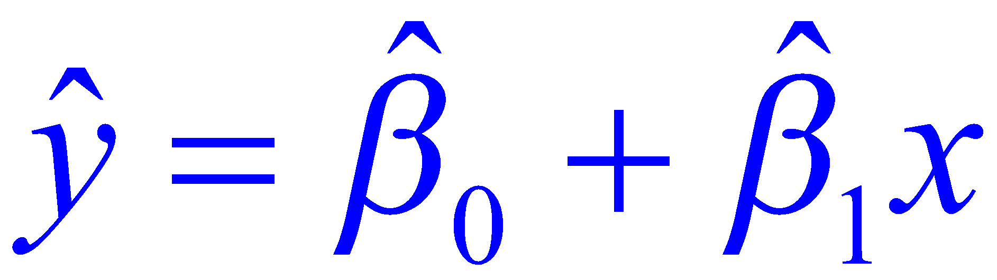
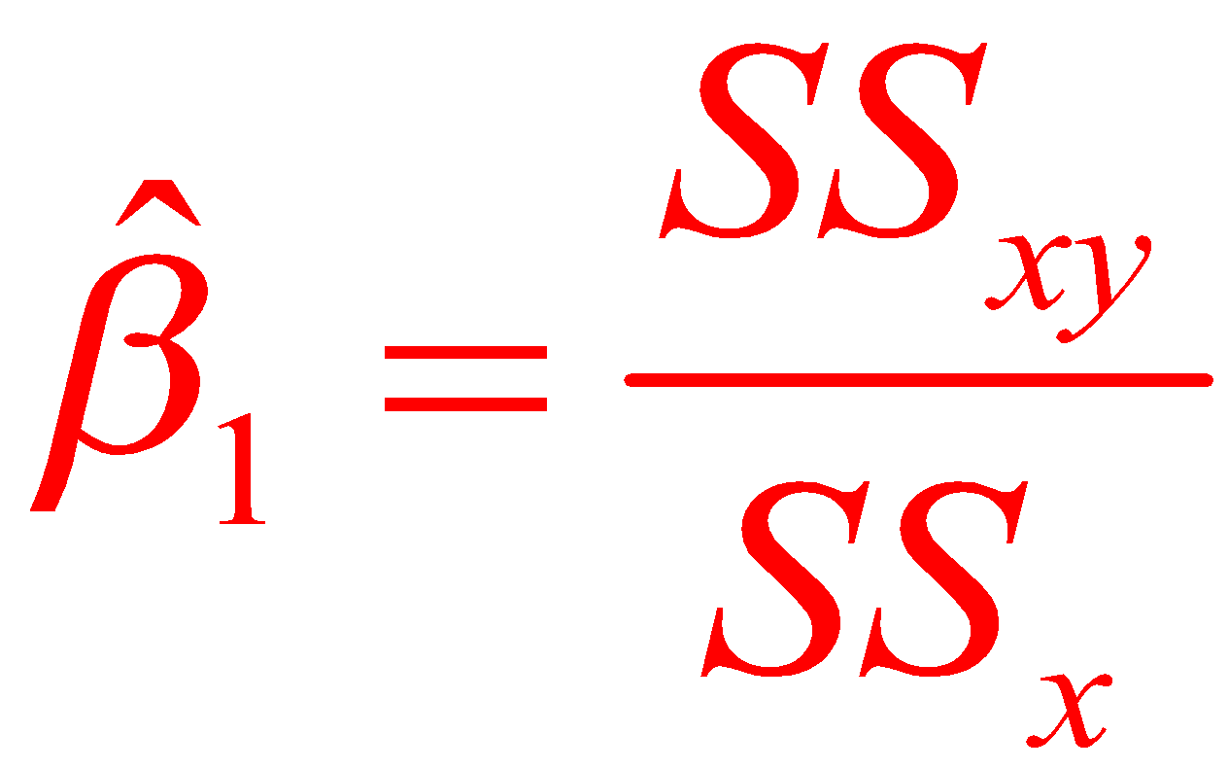
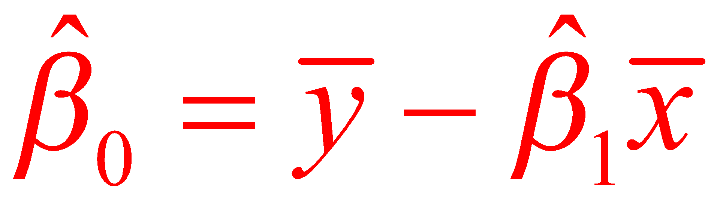
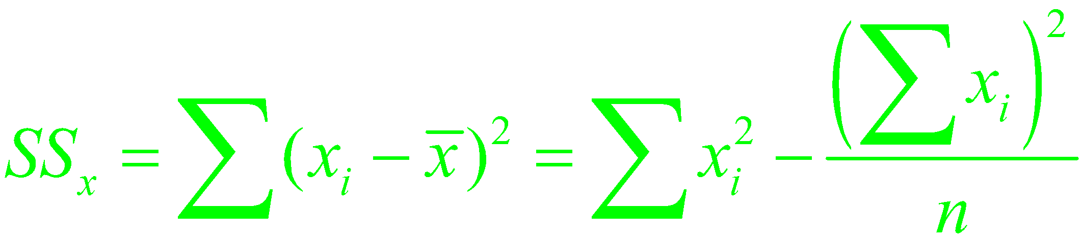
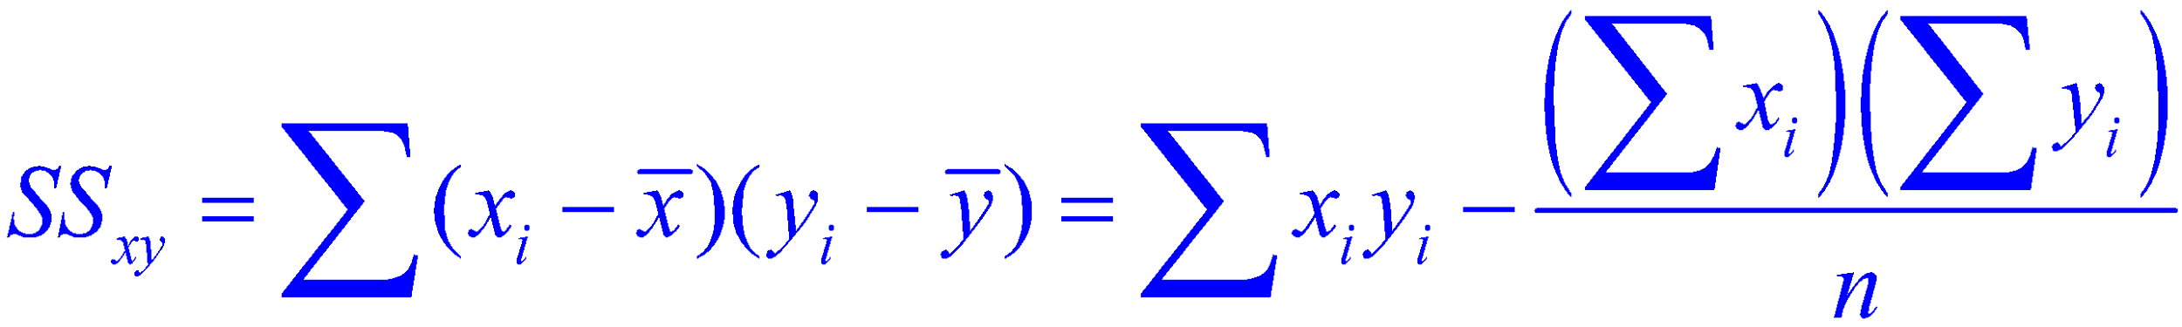
The Simple Linear Regression Model
The Least Squares Regression Line where
11
Notes:
11

Slide 12
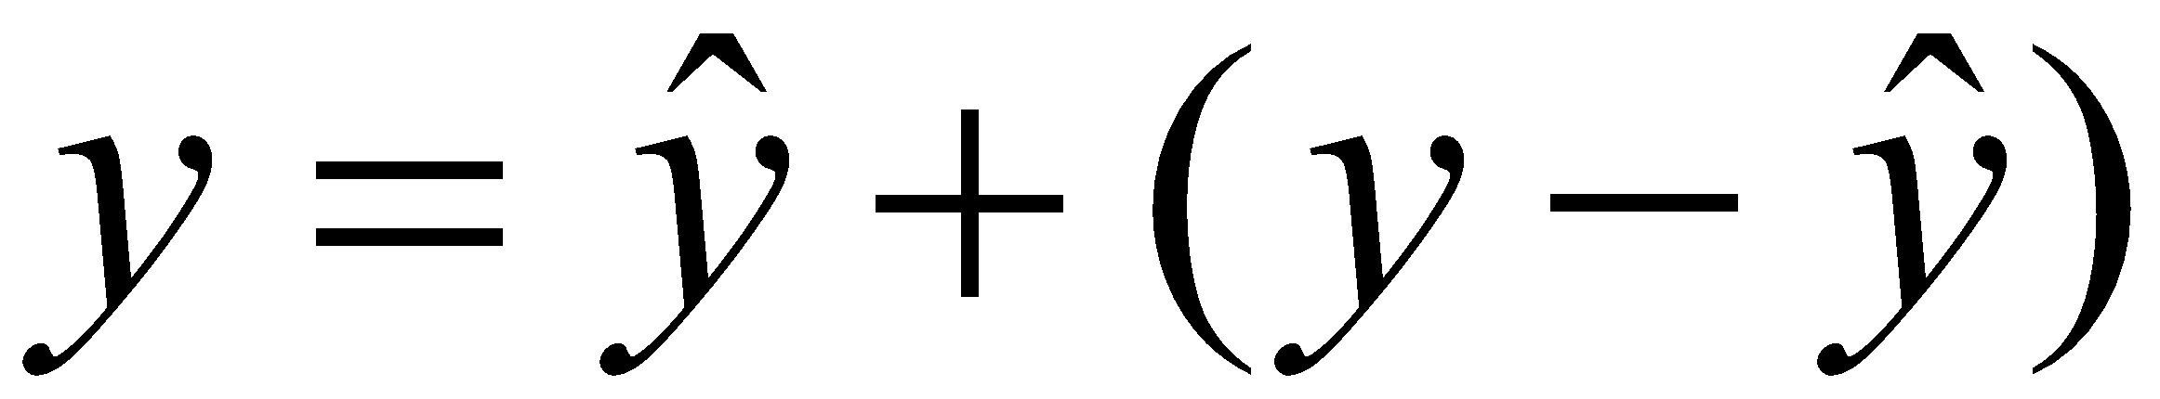
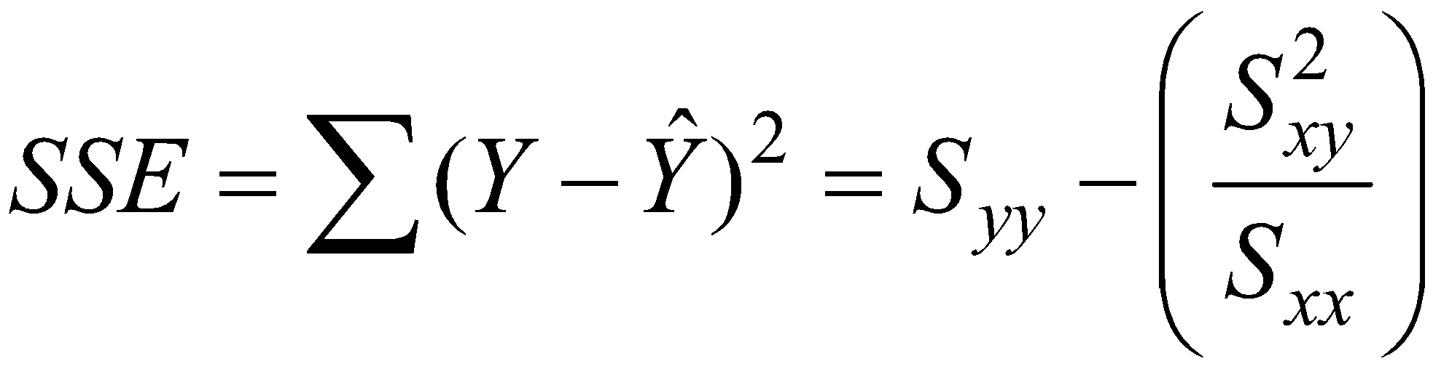
What form does the error take?
Each observation may be decomposed into two parts:
The first part is used to determine the fit, and the second to estimate the error.
We estimate the standard deviation of the error by:
12
Notes:
12

Slide 13
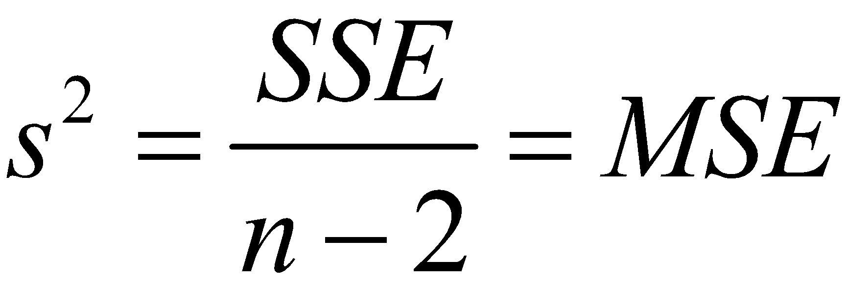
Estimate of σ²
We estimate σ² by
13

Slide 14
Example
An educational economist wants to establish the relationship between an individual’s income and education. He takes a random sample of 10 individuals and asks for their income ( in $1000s) and education ( in years). The results are shown below. Find the least squares regression line.
Education
11 | 12 | 11 | 15 | 8 | 10 | 11 | 12 | 17 | 11
25 | 33 | 22 | 41 | 18 | 28 | 32 | 24 | 53 | 26
Income
14

Slide 15
Dependent and Independent Variables
The dependent variable is the one that we want to forecast or analyze.
The independent variable is hypothesized to affect the dependent variable.
In this example, we wish to analyze income and we choose the variable individual’s education that most affects income. Hence, y is income and x is individual’s education
15

Slide 16
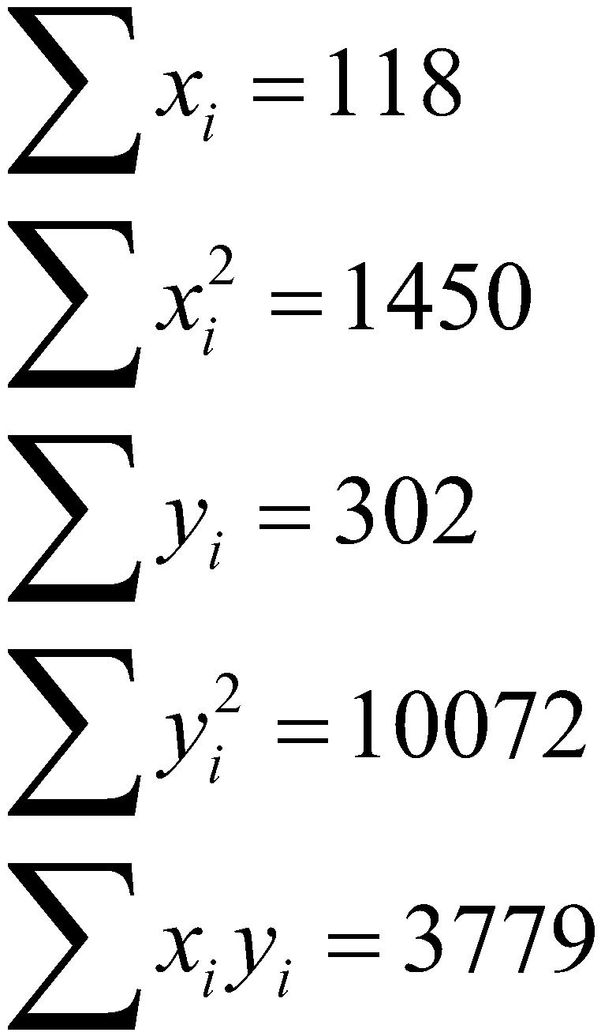
First Step:
16

Slide 17
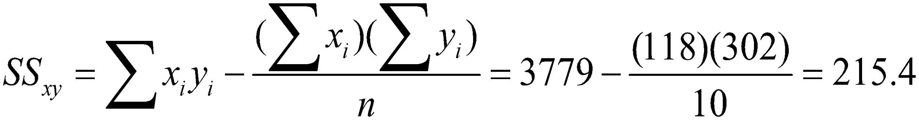
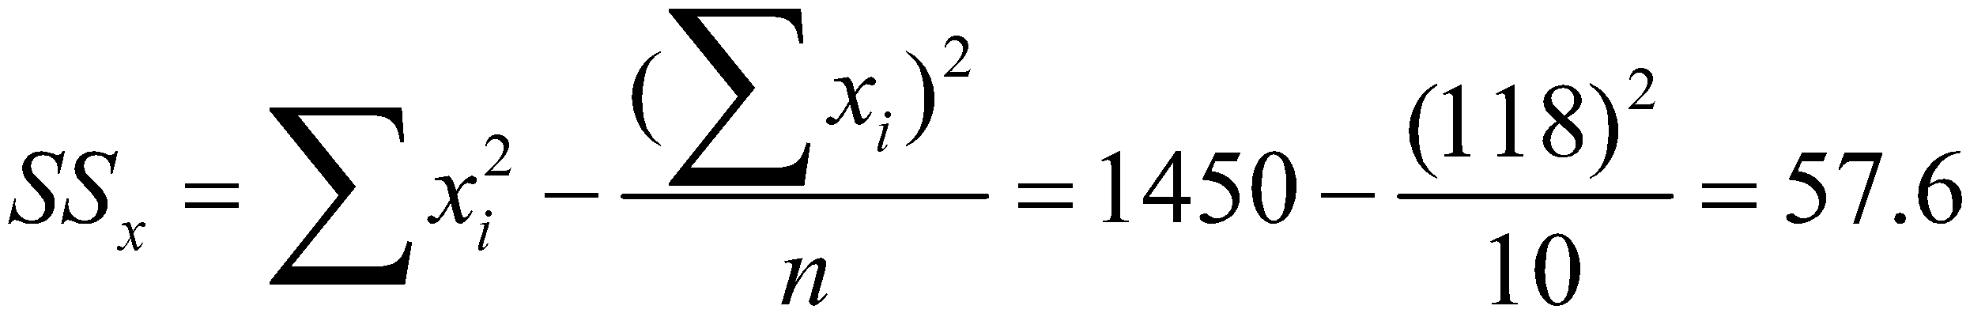
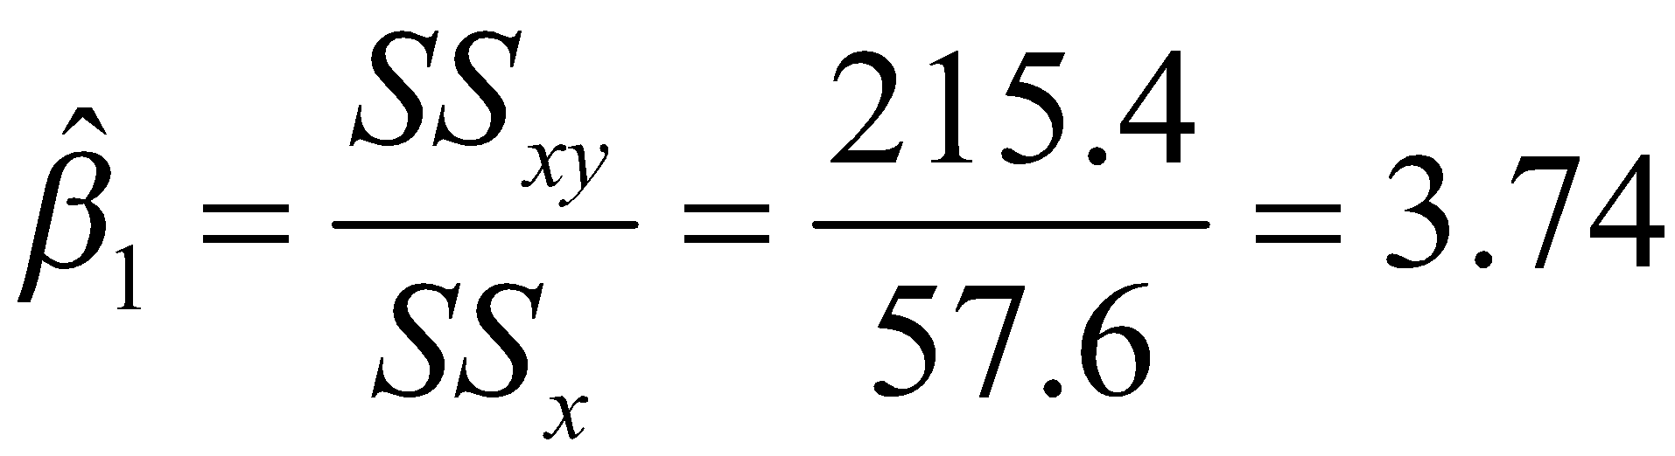
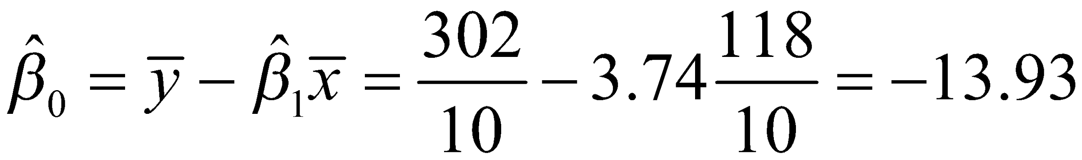
Sum of Squares:
Therefore,
17
Notes:
17

Slide 18
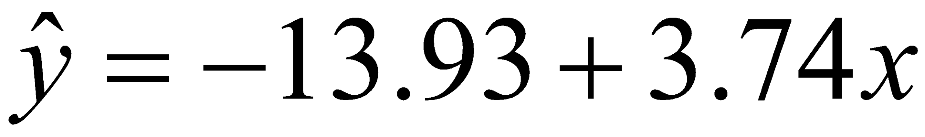
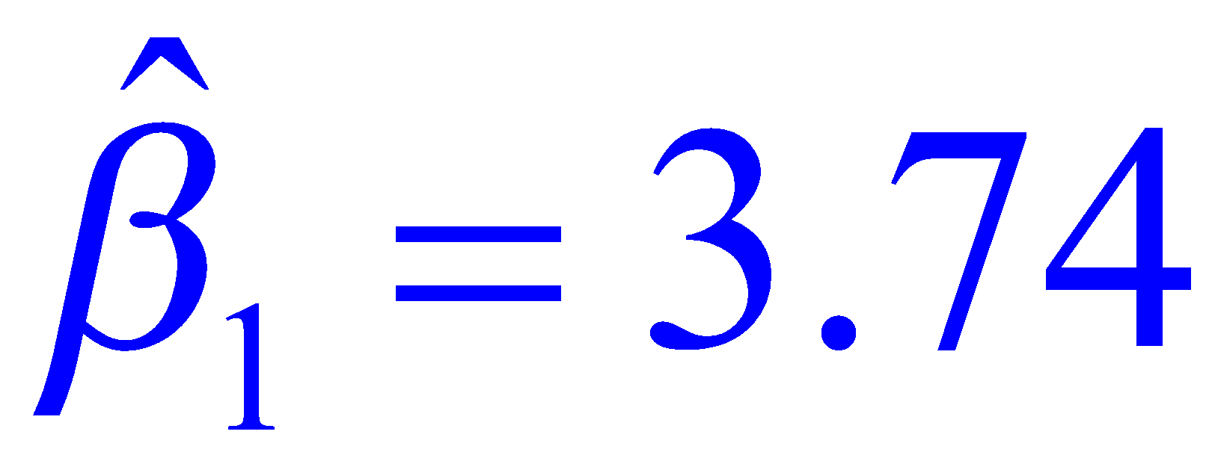
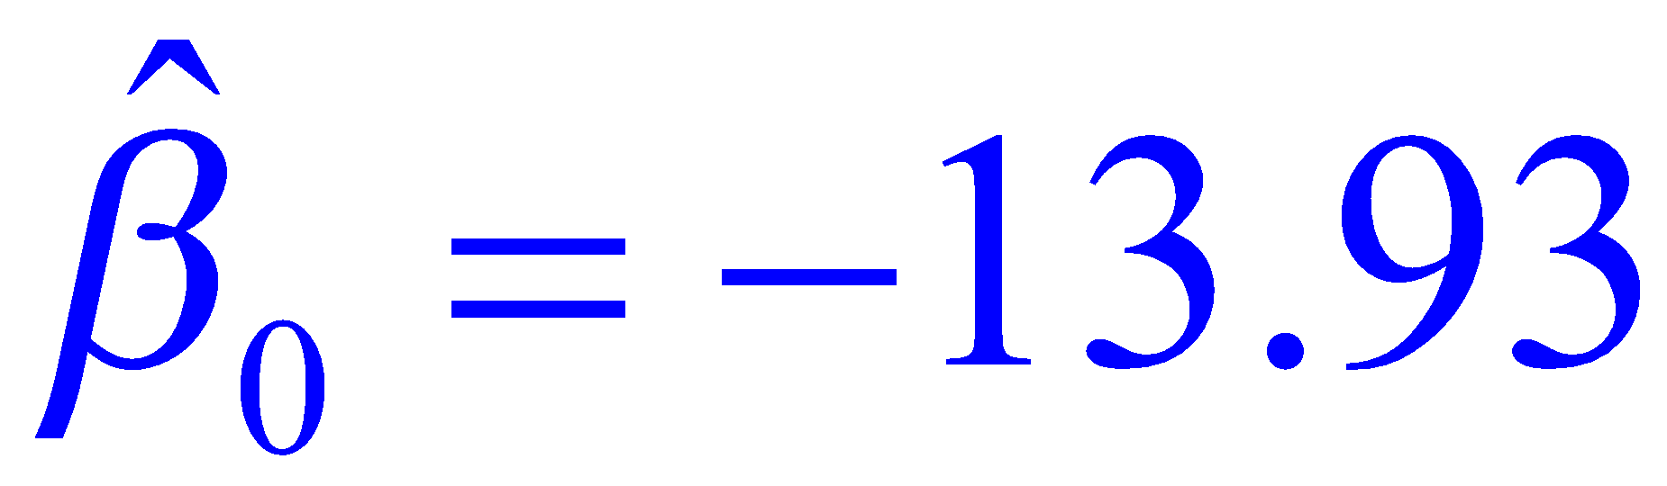
The Least Squares Regression Line
The least squares regression line is
Interpretation of coefficients:
*The sample slope tells us that on average for each additional year of education, an individual’s income rises by $3.74 thousand.
The y-intercept is . This value is the expected (or average) income for an individual who has 0 education level (which is meaningless here)
18

Slide 19
Example
Car dealers across North America use the red book to determine a cars selling price on the basis of important features. One of these is the car’s current odometer reading.
To examine this issue 100 three-year old cars in mint condition were randomly selected. Their selling price and odometer reading were observed.
19

Slide 20
Portion of the data file
Odometer Price
37388 5318
44758 5061
45833 5008
30862 5795
….. …
34212 5283
33190 5259
39196 5356
36392 5133
20

Slide 21
Example (Minitab Output)
Regression Analysis
The regression equation is
Price = 6533 - 0.0312 Odometer
Predictor Coef StDev T P
Constant 6533.38 84.51 77.31 0.000(SIGNIFICANT)
Odometer -0.031158 0.002309 -13.49 0.000(SIGNIFICANT)
S = 151.6 R-Sq = 65.0% R-Sq(adj) = 64.7%
Analysis of Variance
Source DF SS MS F P
Regression 1 4183528 4183528 182.11 0.000
Error 98 2251362 22973
Total 99 6434890
21

Slide 22
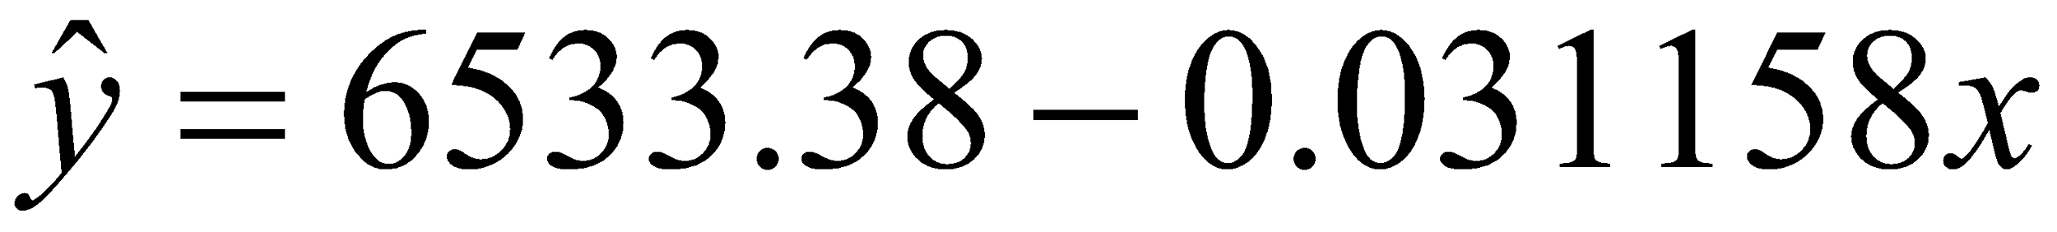
Example
The least squares regression line is
6
0
0
0
e
5
5
0
c
0
i
r
P
5
0
0
0
2
0
0
0
0
3
0
0
0
0
4
0
0
0
0
5
0
0
0
0
22
O
d
o
m
e
t
e
r

Slide 23
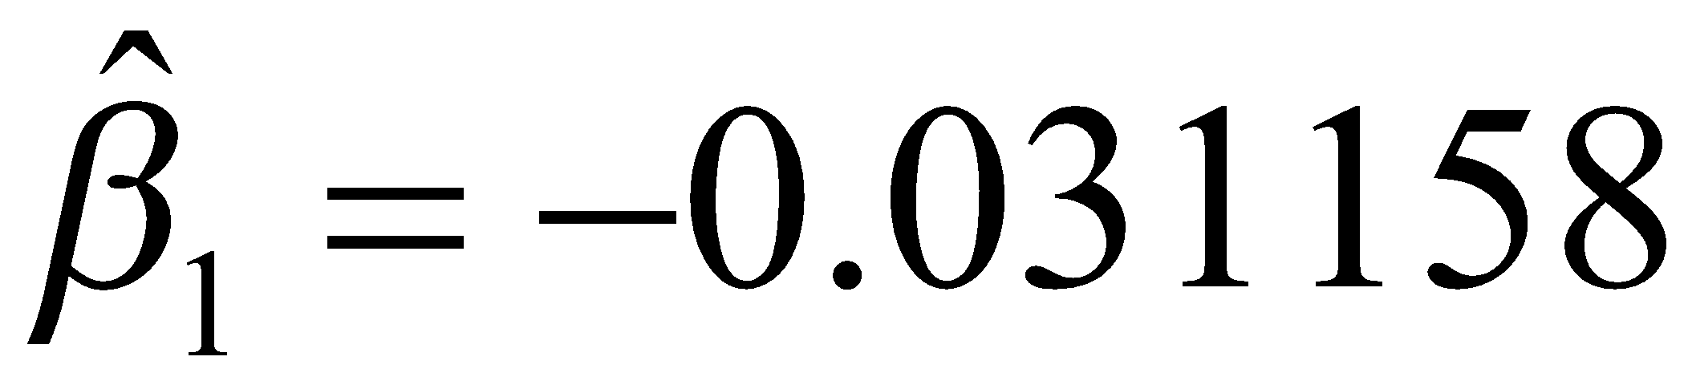
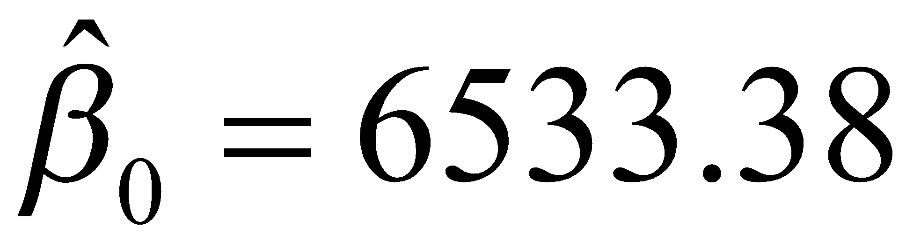
Interpretation of the coefficients
means that for each additional mile on the odometer, the price decreases by an average of 3.1158 cents.
means that when x = 0 (new car), the selling price is $6533.38 but x = 0 is not in the range of x. So, we cannot interpret the value of y when x=0 for this problem.
R²=65.0% means that 65% of the variation of y can be explained by x. The higher the value of R², the better the model fits the data.
23

Slide 24
R² and R² adjusted
R² measures the degree of linear association between X and Y.
So, an R² close to 0 does not necessarily indicate that X and Y are unrelated (relation can be nonlinear)
Also, a high R² does not necessarily indicate that the estimated regression line is a good fit.
As more and more X’s are added to the model, R² always increases. R²adj accounts for the number of parameters in the model.
24

Slide 25
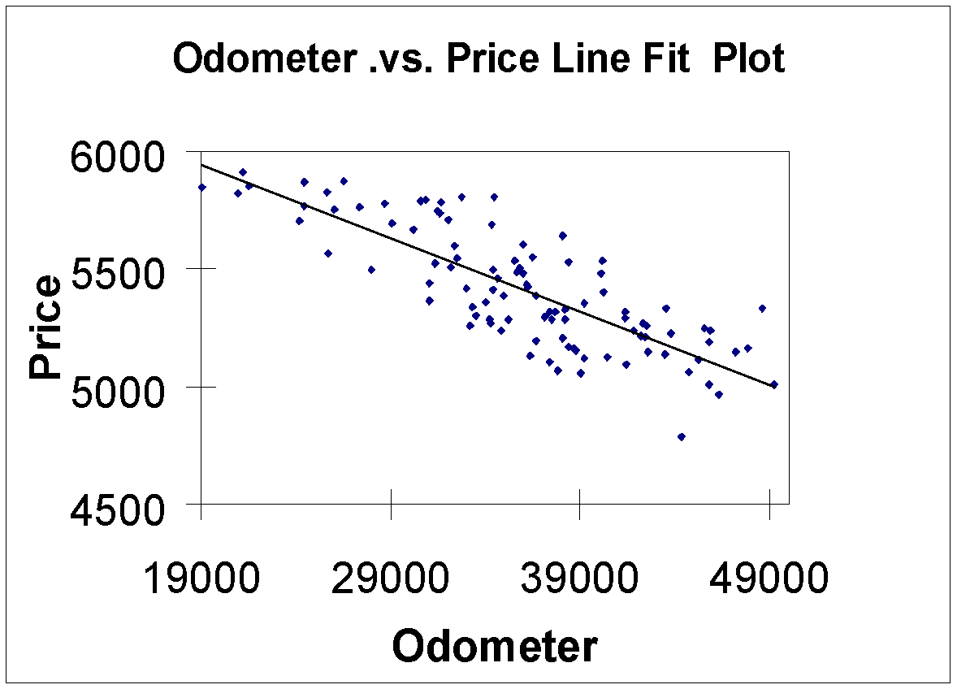
Scatter Plot
25

Slide 26
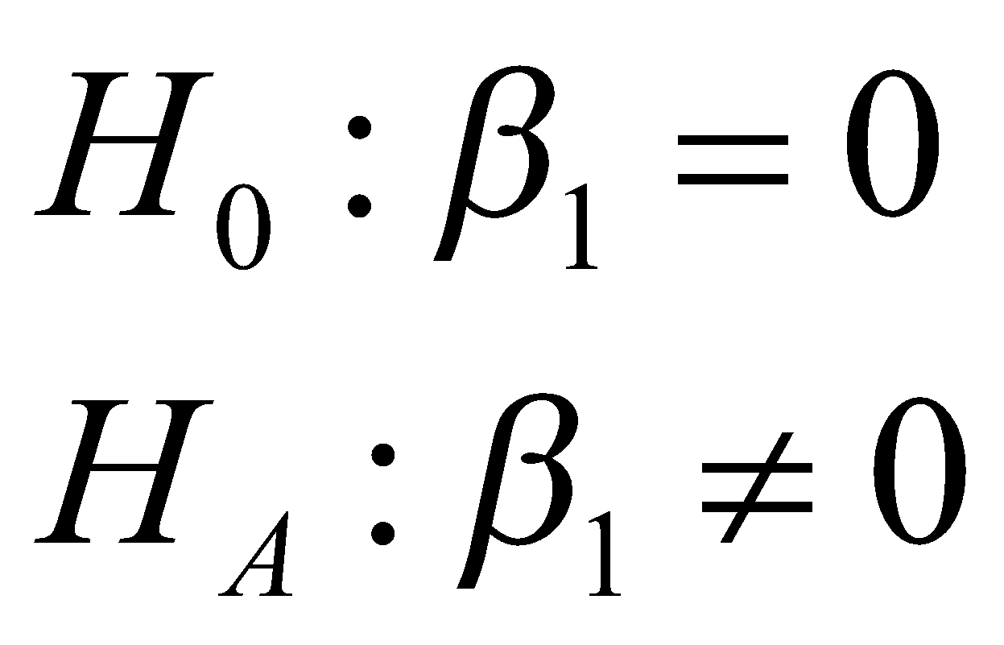
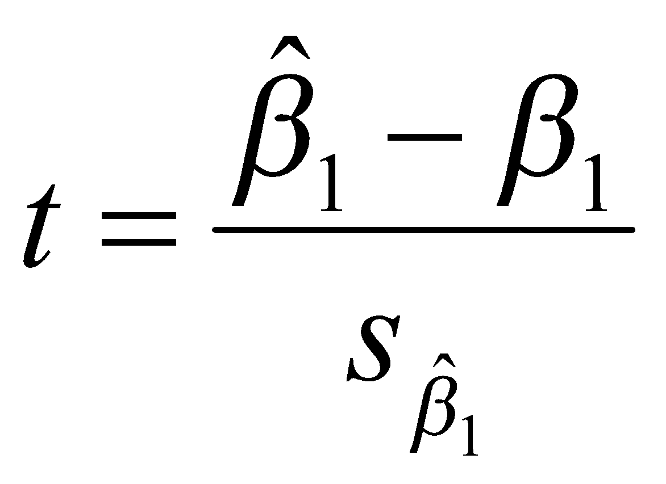
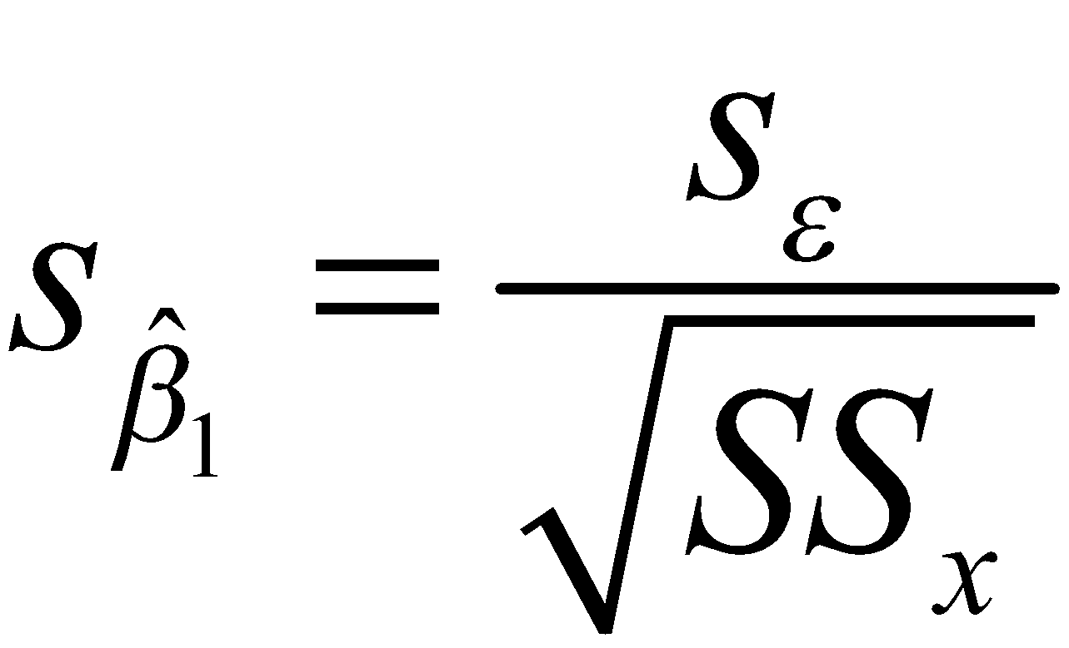
Testing the slope
Are X and Y linearly related?
Test Statistic:
where
26

Slide 27
Testing the slope (continue)
The Rejection Region:
Reject H₀ if t < -t_{α/2,n-2} or t > t_{α/2,n-2}.
If we are testing that high x values lead to high y values, H_{A}: β₁>0. Then, the rejection region is
t > t_{α,n-2}.
If we are testing that high x values lead to low y values or low x values lead to high y values, H_{A}: β₁ <0. Then, the rejection region is t < - t_{α,n-2}.
27

Slide 28
Assessing the model
Example:
Excel output
Minitab output
Coefficients Standard Error t Stat P-value
Intercept 6533.4 84.512322 77.307 1E-89
Odometer -0.031 0.0023089 -13.49 4E-24
Predictor Coef StDev T P
Constant 6533.38 84.51 77.31 0.000
Odometer -0.031158 0.002309 -13.49 0.000
28

Slide 29
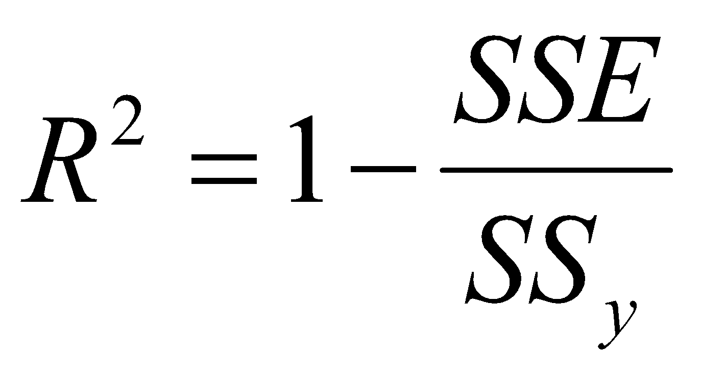
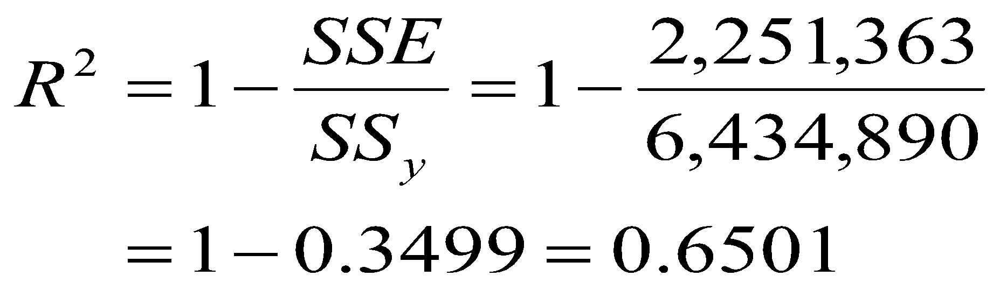
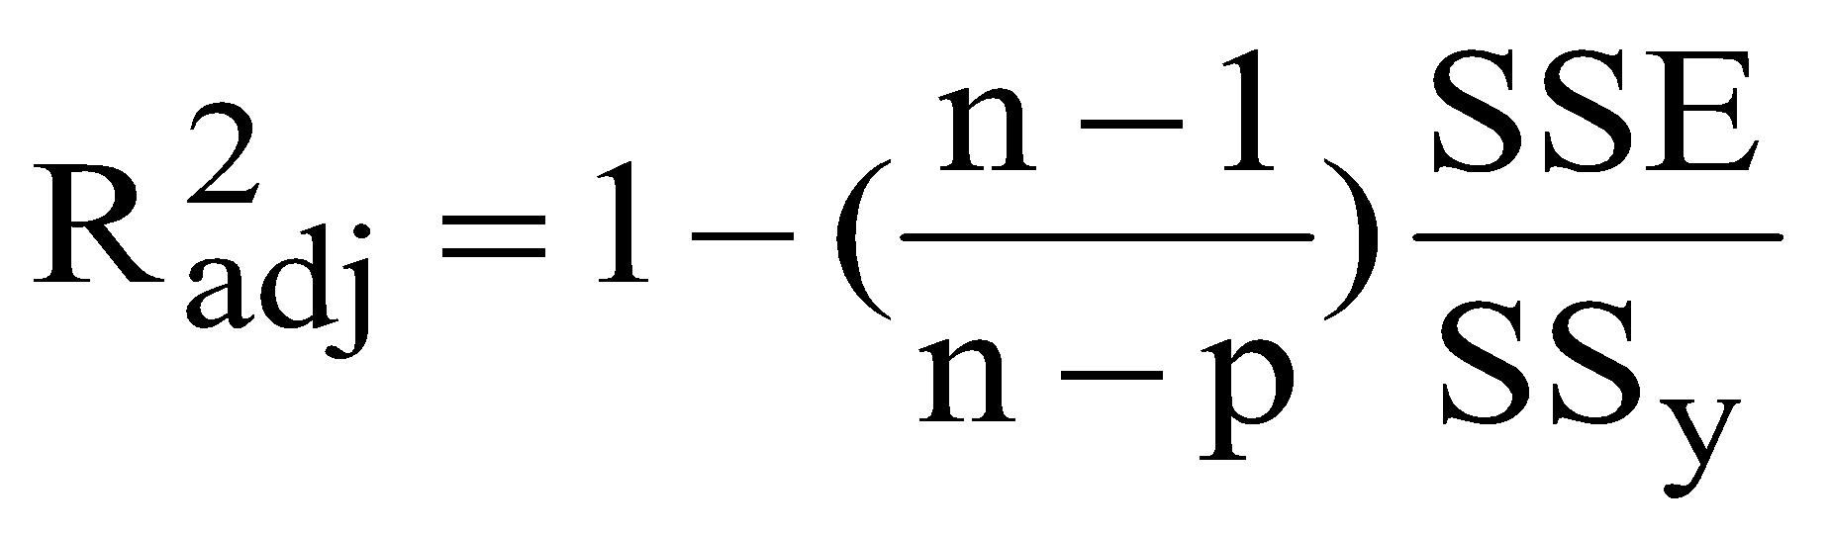
Coefficient of Determination
For the data in odometer example, we obtain:
where p is number of predictors in the model.
29

Slide 30
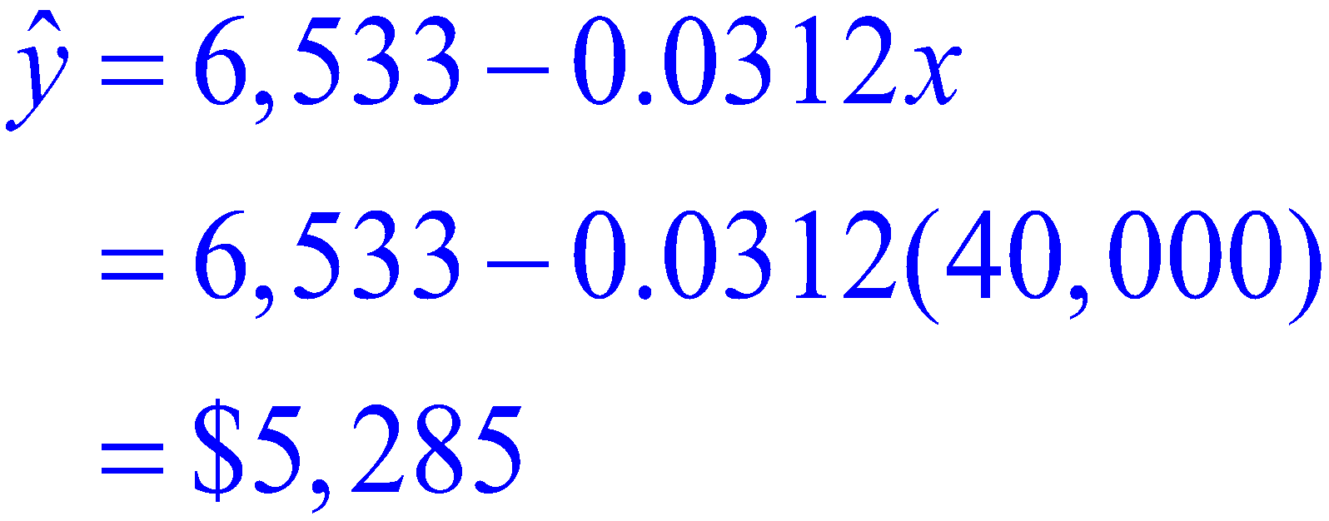
Using the Regression Equation
Suppose we would like to predict the selling price for a car with 40,000 miles on the odometer
30

Slide 31
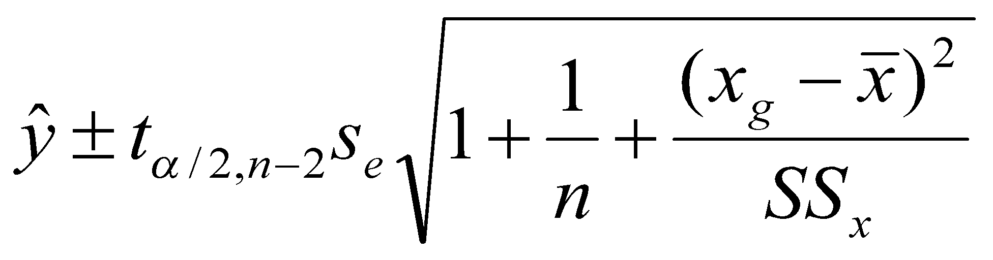
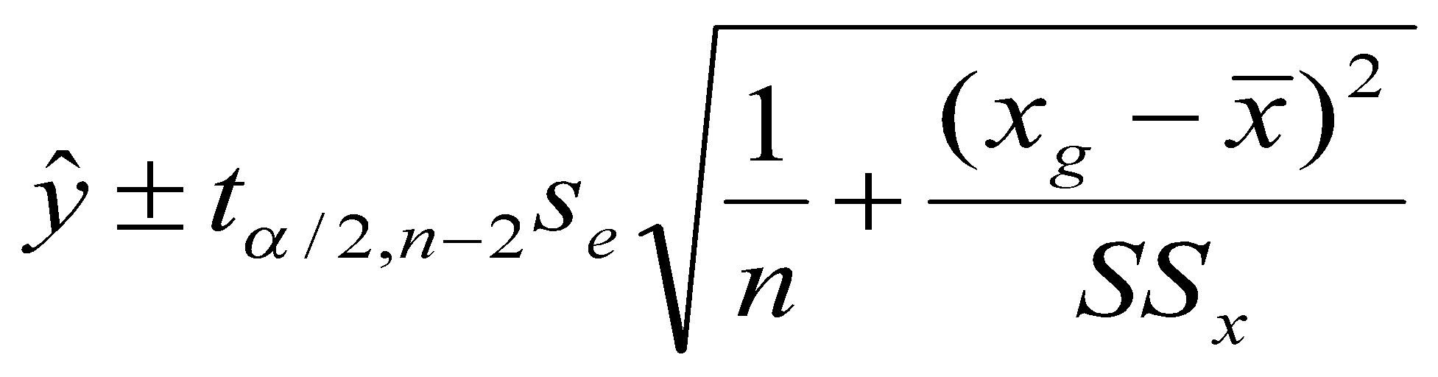
Prediction and Confidence Intervals
Prediction Interval of y for x=x_{g}: The confidence interval for predicting the particular value of y for a given x
Confidence Interval of E(y|x=x_{g}): The confidence interval for estimating the expected value of y for a given x
31

Slide 32
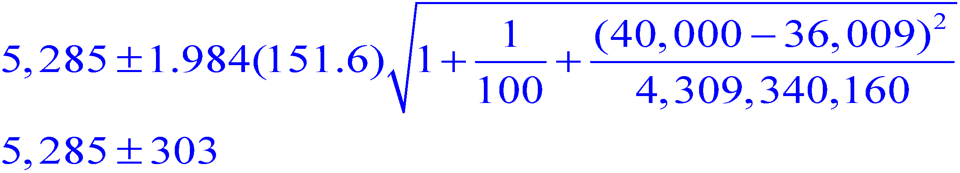
Solving by Hand (Prediction Interval)
From previous calculations we have the following estimates:
Thus a 95% prediction interval for x=40,000 is:
The prediction is that the selling price of the car
will fall between $4982 and $5588.
32

Slide 33
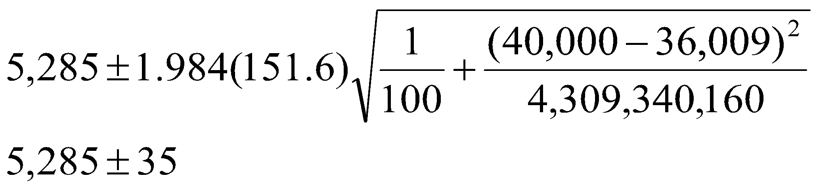
Solving by Hand (Confidence Interval)
A 95% confidence interval of
E(y| x=40,000) is:
The mean selling price of the car will fall between $5250
and $5320.
33

Slide 34
Prediction and Confidence Intervals’ Graph
6
3
0
0
P
r
e
d
i
c
t
i
o
n
i
n
t
e
r
v
a
l
5
8
0
d
0
e
t
c
i
d
e
r
P
5
3
0
0
C
o
n
f
i
d
e
n
c
e
i
n
t
e
r
v
a
l
4
8
0
0
2
0
0
0
0
3
0
0
0
0
4
0
0
0
0
5
0
0
0
0
O
d
o
m
e
t
e
r
34

Slide 35
Notes
No matter how strong is the statistical relation between X and Y, no cause-and-effect pattern is necessarily implied by the regression model. Ex: Although a positive and significant relationship is observed between vocabulary (X) and writing speed (Y), this does not imply that an increase in X causes an increase in Y. Other variables, such as age, may affect both X and Y. Older children have a larger vocabulary and faster writing speed.
35

Slide 36
Regression Diagnostics
Residual Analysis:
⇒Non-normality
⇒Heteroscedasticity (non-constant variance)
⇒Non-independence of the errors
⇒Outlier
⇒Influential observations
36

Slide 37
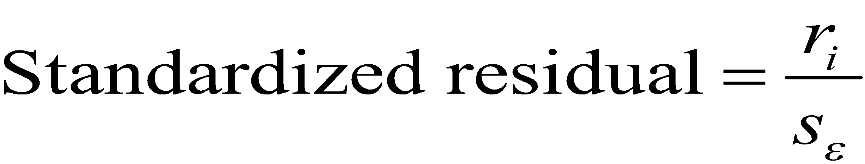
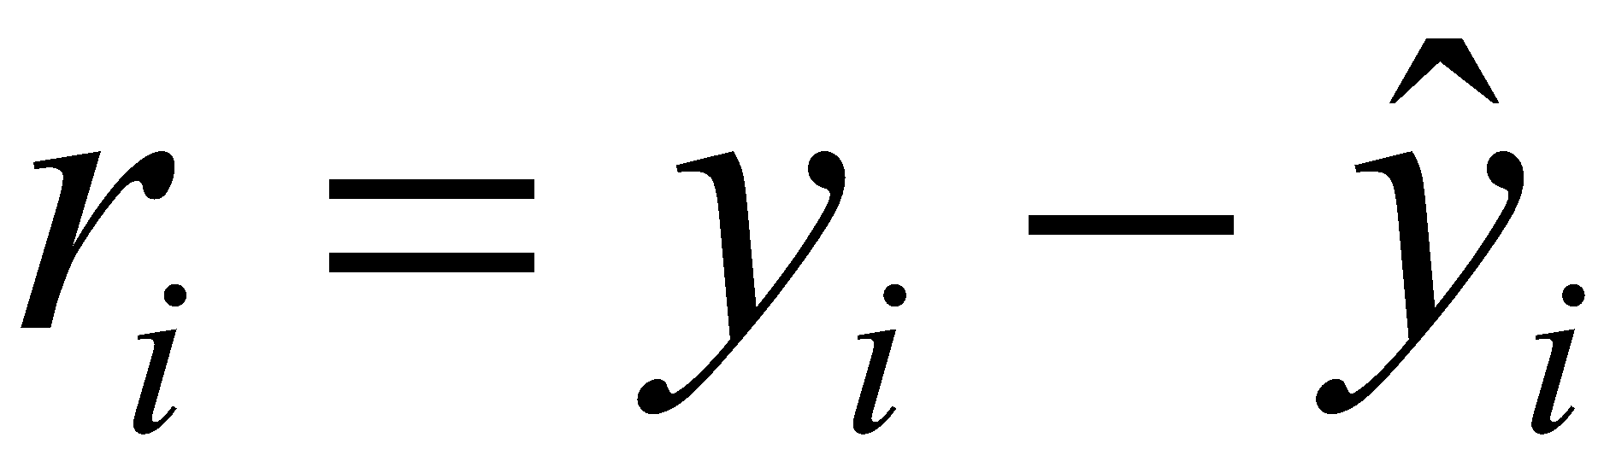

Standardized Residuals
The standardized residuals are calculated as
where .
The standard deviation of the i-th residual is
37

Slide 38
Non-normality:
The errors should be normally distributed. To check the normality of errors, we use histogram of the residuals or normal probability plot of residuals or tests such as Shapiro-Wilk test.
Dealing with non-normality:
Transformation on Y
Other types of regression (e.g., Poisson or Logistic …)
Nonparametric methods (e.g., nonparametric regression(i.e. smoothing))
38

Slide 39

Non-constant variance:
The error variance should be constant.
To diagnose non-constant variance, one method is to plot the residuals against the predicted value of y (or x). If the points are distributed evenly around the expected value of errors which is 0, this means that the error variance is constant. Or, formal tests such as: Breusch-Pagan test
39

Slide 40

Dealing with non-constant variance
Transform Y
Re-specify the Model (e.g., Missing important X’s?)
Use Weighted Least Squares instead of Ordinary Least Squares
40

Slide 41
Non-independence of error variable:
The values of error should be independent. When the data are time series, the errors often are correlated (i.e., autocorrelated or serially correlated). To detect autocorrelation we plot the residuals against the time periods. If there is no pattern, this means that errors are independent. Or, more formal tests such as Durbin-Watson
41

Slide 42
Outlier:
An outlier is an observation that is unusually small or large. Two possibilities which cause outlier is
Error in recording the data.⇒ Detect the error and correct it
The outlier point should not have been included in the data (belongs to another population) ⇒ Discard the point from the sample
2. The observation is unusually small or large although it belong to the sample and there is no recording error. ⇒ Do NOT remove it
42

Slide 43


Influential Observations
43

Slide 44
Influential Observations
Detection:
Cook’s Distance, DFFITS, DFBETAS (Neter, J., Kutner, M.H., Nachtsheim, C.J., and Wasserman, W., (1996) Applied Linear Statistical Models, 4th edition, Irwin, pp. 378-384)
44

Slide 45
Multicollinearity
A common issue in multiple regression is multicollinearity. This exists when some or all of the predictors in the model are highly correlated. In such cases, the estimated coefficient of any variable depends on which other variables are in the model. Also, standard errors of the coefficients are very high…
45

Slide 46
Multicollinearity
Look into correlation coefficient among X’s: If Cor>0.8, suspect multicollinearity
Look into Variance inflation factors (VIF): VIF>10 is usually a sign of multicollinearity
If there is multicollinearity:
Use transformation on X’s, e.g. centering, standardization. Ex: Cor(X,X²)=0.991; after standardization Cor=0!
Remove the X that causes multicollinearity
Factor analysis
Ridge regression
…
46

Slide 47
Exercise
In baseball, the fans are always interested in determining which factors lead to successful teams. The table below lists the team batting average and the team winning percentage for the 14 league teams at the end of a recent season.
47

Slide 48

y = winning % and x = team batting average
48

Slide 49


a) LS Regression Line
49

Slide 50



The least squares regression line is
The meaning is for each additional batting average of the team, the winning percentage increases by an average of 79.41%.
50

Slide 51


b) Standard Error of Estimate
So,
Since s_{ε}=0.0567 is small, we would conclude that “s” is relatively small, indicating that the regression line fits the data quite well.
51

Slide 52


c) Do the data provide sufficient evidence at the 5% significance level to conclude that higher team batting average lead to higher winning percentage?
Conclusion: Do not reject H₀ at α = 0.05. The higher team batting average does not lead to higher winning percentage.
52

Slide 53

d)Coefficient of Determination
The 19.25% of the variation in the winning percentage
can be explained by the batting average.
53

Slide 54

e) Predict with 90% confidence the winning percentage of a team whose batting average is 0.275.
90% PI for y:
The prediction is that the winning percentage of the team will fall between 39.85% and 62.53%.
54

